Slide 1
Conjugating Verbs in the Present Tense

Slide 2
What is an infinitive?
An infinitive is:
An unconjugated verb that:
In Spanish ends in “AR” “ER” or “IR”
In English always starts with “to”

Slide 3
AR Infinitives

Slide 4
Buscar: To look for
Sacar: to take out
Hablar: to speak/talk
Cocinar: to cook
Comprar: to buy
Practicar: to practice
Caminar: to walk
Estudiar: to study
Mirar: to see
Trabajar: to work
Viajar: to travel
Terminar: to finish
Pintar: to paint
Tomar: to drink/to take
Necesitar: to need
Entrar: to enter
Llevar: to carry/to bring
Llegar: to arrive

Slide 5
Bailar: to dance
Cantar: to sing
Correr: to run
Dibujar: to draw
Escuchar música: to listen to music
Esquiar: to ski
Hablar por teléfono: to talk on the phone
Jugar videojuegos: to play videogames

Slide 6
Montar en bicicleta: to ride a bike
Montar en monopatín: to skateboard
Nadar: to swim
Pasar tiempo con amigos: to spend time with friends
Patinar: to skate
Practicar deportes: to practice sports
Tocar la guitarra: to play the guitar
Trabajar: to work
Usar la computadora: to use the computer

Slide 7
How do I conjugate verbs?

Slide 8
1.) Decide what kind of verb you have: AR, ER/IR
2.) Decide what pronoun you are conjugating for
Note: If you are given a proper noun instead of a pronoun, think about what pronoun WOULD replace the proper noun to help you figure out what ending to use
3.) Drop your AR, ER/IR ending
4.) Find the ending that matches your pronoun and add the new ending

Slide 9
AR Conjugation Endings
Yo -o | Nosotros- -amos
Tú -as
Él/Ella/Usted -a | Ellos/Ellas/Ustedes -an

Slide 10
Conjugate the verb in parenthesis based on the pronoun given

Slide 11
Nosotros (comprar)

Slide 12
Tú (cocinar)

Slide 13
Greg and Shannon (practicar)

Slide 14
Usted (cantar)

Slide 15
Yo (escuchar)

Slide 16
Translate the following phrases from English to Spanish

Slide 17
Y’all ski

Slide 18
I study

Slide 19
She speaks

Slide 20
We look for

Slide 21
You use

Slide 22
Conjugating ER/IR Verbs

Slide 23
Escribir: to write *Beber: to drink
Abrir: to open *Barrer: to sweep
Recibir: to receive *Comprender: to understand
Vivir: to live *Vender: to sell
Comer: to eat *Leer: to read
Correr: to run *Describir: to describe
Aprender: to learn *Decidir: to decide
Responder: to respond *Discutir: to discuss
Salir: to leave *Ver la tele: to watch tv

Slide 24
ER/IR
Yo -o | Nosotros/Nosotras -emos/-imos
Tú -es
Él/Ella/Usted -e | Ellos/Ellas/Ustedes -en

Slide 25
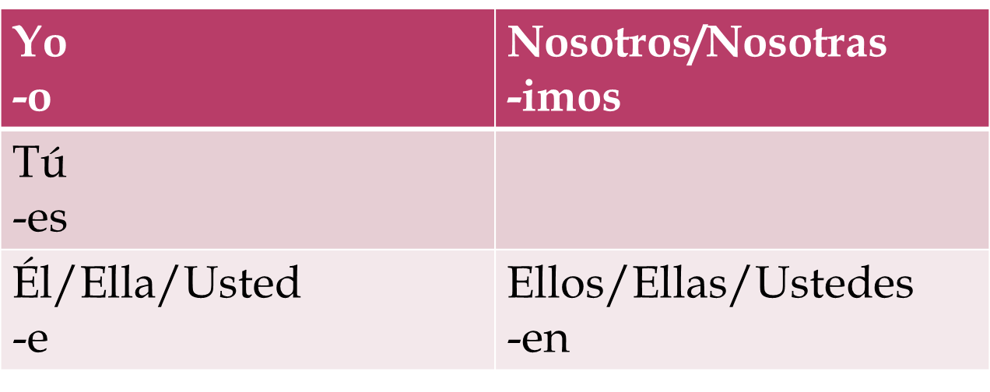
IR

Slide 26
Ellos (abrir)

Slide 27
Tú (barrer)

Slide 28
Usted (comprender)

Slide 29
Nosotras (leer)

Slide 30
Yo (aprender)

Slide 31
Tranlate the following phrases from English to Spanish

Slide 32
We (all girls) open

Slide 33
Y’all run

Slide 34
You sweep

Slide 35
He sells

Slide 36
I eat

