Slide 1
Los Pasatiempos: Hobbies

Slide 2
What is an infinitive?
An unconjugated verb
In Spanish: always ends with “ar” “er” or “ir”
When translated into English: always starts with “to”
Ex:
English: to play, to run, to write
Spanish: jugar, correr, escribir

Slide 3
AR VERBS

Slide 4
BAILAR: TO DANCE

Slide 5
CANTAR: TO SING

Slide 6
DIBUJAR: TO DRAW

Slide 7
ESQUIAR: TO SKI

Slide 8
ESCUCHAR MÚSICA: TO LISTEN TO MUSIC

Slide 9
HABLAR POR TELÉFONO: TO TALK ON THE PHONE

Slide 10
JUGAR VIDEOJUEGOS: TO PLAY VIDEOGAMES

Slide 11
MONTAR EN BICICLETA: TO RIDE A BIKE

Slide 12
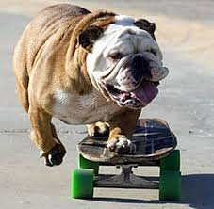
MONTAR EN MONOPATÍN: TO SKATEBOARD

Slide 13
NADAR: TO SWIM

Slide 14
PASAR TIEMPO CON AMIGOS: TO SPEND TIME WITH FRIENDS

Slide 15
PATINAR: TO SKATE

Slide 16
PRACTICAR DEPORTES: TO PRACTICE SPORTS

Slide 17
TOCAR LA GUITARRA: TO PLAY THE GUITAR

Slide 18
TRABAJAR: TO WORK

Slide 19
USAR LA COMPUTADORA: TO USE THE COMPUTER

Slide 20
ER/IR VERBS

Slide 21
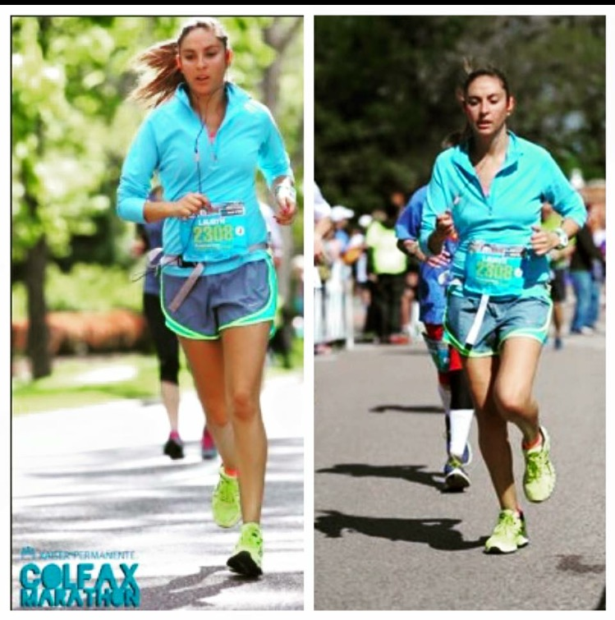
CORRER: TO RUN

Slide 22
LEER REVISTAS: TO READ MAGAZINES

Slide 23
ESCRIBIR CUENTOS: TO WRITE STORIES

Slide 24
IR A LA ESCUELA: TO GO TO SCHOOL

Slide 25
VER LA TELE: TO WATCH TV

Slide 26
Me gusta
Always use the SINGULAR form of “me gusta”!
Add the infinitive
EX: I like to sing= Me gusta cantar
Always use the SINGULAR form of “no me gusta”
Ad the infinitive
EX: I don’t like to ski= No me gusta esquiar.

Slide 27
I like to watch tv.
I like to swim.
I don’t like to run.
I don’t like to write stories.

Slide 28
Translate or answer the following questions
To play videogames

Slide 29
I like to write stories.

Slide 30
No me gusta practicar deportes.

Slide 31
Leer revistas

Slide 32
I don’t like to swim

Slide 33
To play the guitar

Slide 34
Me gusta comer.

Slide 35
No me gusta esquiar.

Slide 36
Patinar

Slide 37
I don’t like to talk on the phone.

