Slide 1
The Present Subjunctive

Slide 2
What is it?
Up to this point we have used what is called the “indicative mood”, which is used to talk about facts or actual events
Present tense
Past tense
The subjunctive mood is used to talk about how one person influences the actions of another
It does not deal with factual reality but rather opinions, feelings, dreams and speculation

Slide 3
How do we form it?
A subjunctive sentence has two parts
Part 1: uses the present indicative verb (the recommendation, suggestion, etc) + que
Part 2: uses the present subjunctive verb (what should happen)

Slide 4
AR
-e | -emos
-es
-e | -en

Slide 5
ER/IR
-a | -amos
-as
-a | an

Slide 6
Common first-part indicative verbs
Decir *querer
Insistir en *recomendar
Necesitar *sugerir
Permitir *WEIRDOS
Preferir (e→ie)
Prohibir

Slide 7
Stem-changes still apply
Irregular verbs in command form still apply
Gar verbs (gue)
Car verbs (que)
Ir→vaya
Hacer→haga

Slide 8
Irregulars: Estar
esté | estemos
estés
esté | estén

Slide 9
Dar
dé | demos
dés
dé | dén

Slide 10
Saber
sepa | sepamos
sepas
sepa | sepan

Slide 11
Ser
sea | seamos
seas
sea | sean

Slide 12
Salir
Salgo | Salgamos
Salgas
Salga | Salgan

Slide 13
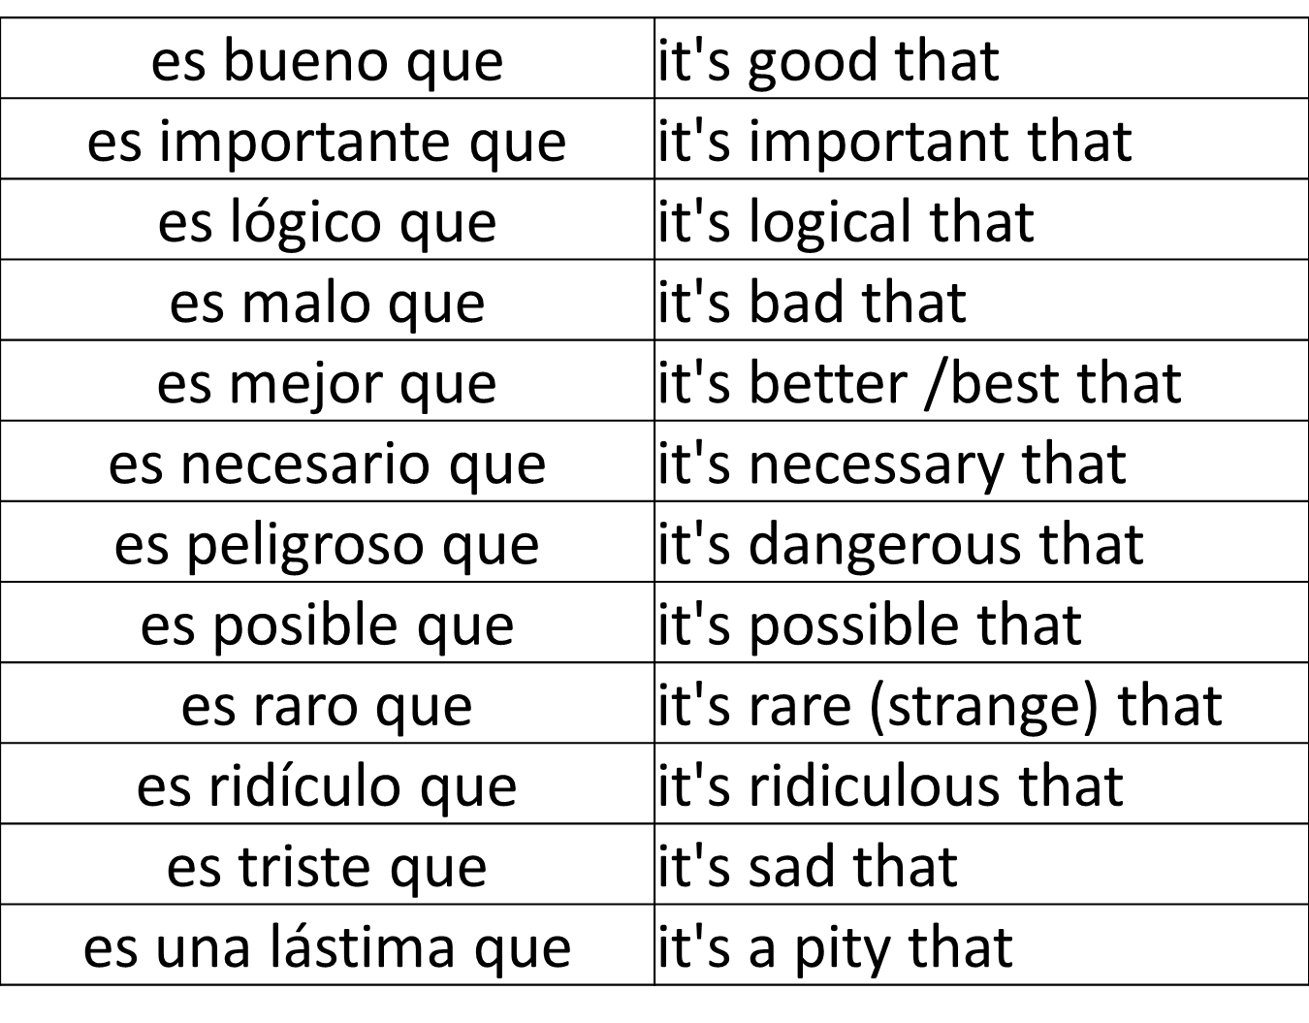
Impersonal Observations…

Slide 14
Speculation… (adverbial clauses)
…a condición de que… | On the condition that
…a menos que… | Unless
…antes de que… | Before
…con tal de que… | Provided that
…en caso de que… | In case
…para que… | So that
…sin que… | Without
…hasta que… | until

